Slide 1


Counterexample-guided synthesis of controller logic from execution traces and temporal formulas
Daniil Chivilikhin, Igor Buzhinsky, Vladimir Ulyantsev,
Andrey Stankevich, Anatoly Shalyto, Valeriy Vyatkin
IEEE ETFA 2018, Turin, Italy
5 September 2018

Slide 2
Program synthesis
Derive implementation from examples/specification
From seminal work [A. Church, 1963]
Motivation
Fundamental in computer science
Automation of software engineering
Reverse engineering
Specification/
examples
Synthesis
Implementation
Notes:
General program synthesis aims to derive the implementation of specific program from behavior examples or formal specification. Thu ultimate goal is automation of software engineering, but in this talk we concentrate on a subproblem - reverse engineering of controllers.

Slide 3
Reverse engineering of control software
SRC
EXE
SRC
?
Maintenance
Reconfiguration
Optimization
Add new functionality
Rights limitations
Changing standards
Data loss
Notes:
Due to various reasons, such as legal rights limitations, constantly changing development standards, or simple data loss, source code of control software becomes unavailable. In order to continue operation of the control system, enable its maintenance, reconfiguration or optimization, source code is essential.

Slide 4
Addressed problem
Construct a model of a black-box logic controller using:
Execution traces derived from the controller
Temporal specification
Formal model of the plant
Notes:
Therefore, in this research we address the problem of constructing a finite-state model of a black-box logic controller. As input data we only use information that can be derived without knowledge of the implementation of the controller. Execution traces can be recorded during normal operation of the system. Temporal specification can be created based on documentation of the legacy system. Finally, the formal model of the plant can be either created manually by an expert or generated automatically using a simulation model.

Slide 5
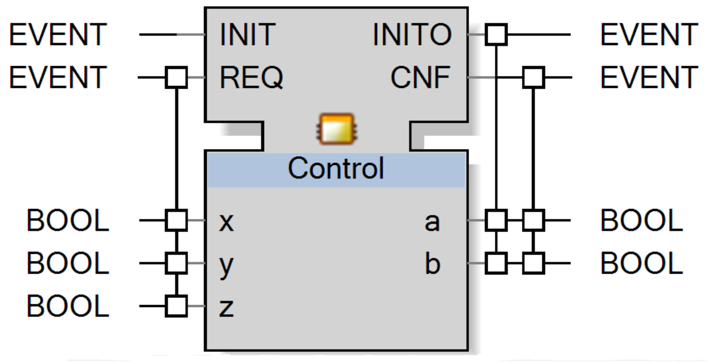
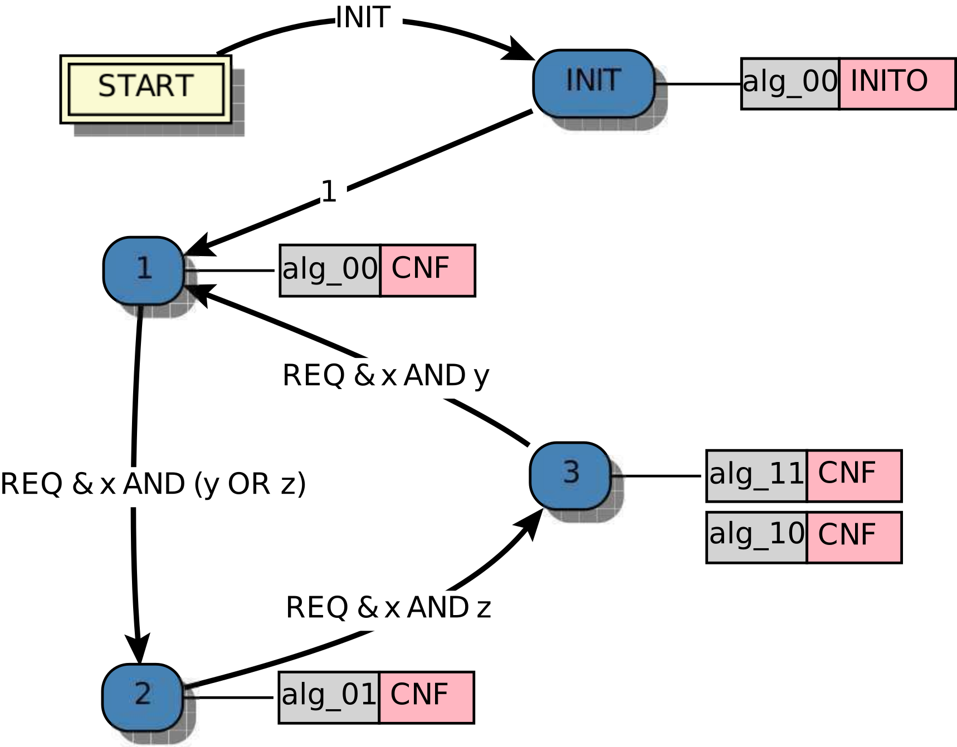
Target language: IEC 61499 basic function blocks
Notes:
In our research we use IEC 61499 basic function blocks as target implementation language. We also restrict all input and output variables of the function block to be logical.

Slide 6
General reverse engineering scheme
Plant model
Simulation
Executiontraces
Model inference
Model
Tests gen
Tests
Temporal properties
Preparation
Synthesis
Notes:
The general scheme involves two steps: data preparation and model synthesis. On the preparation step we derive execution traces of the legacy controller by means of closed-loop simulation testing. Here we also prepare the set of temporal properties that the controller must satisfy as well as the formal model of the plant. The synthesis step uses provided data to generated a controller model

Slide 7
Execution traces
Input event
Input vars
values
Output
event
Output vars values
Notes:
Derived execution traces are, roughly speaking, sequences of snapshots of function block external state. Each element includes the input event and input variable values recorded at the time the input event was registered. Similarly, the output event and output variables values are recorded.

Slide 8
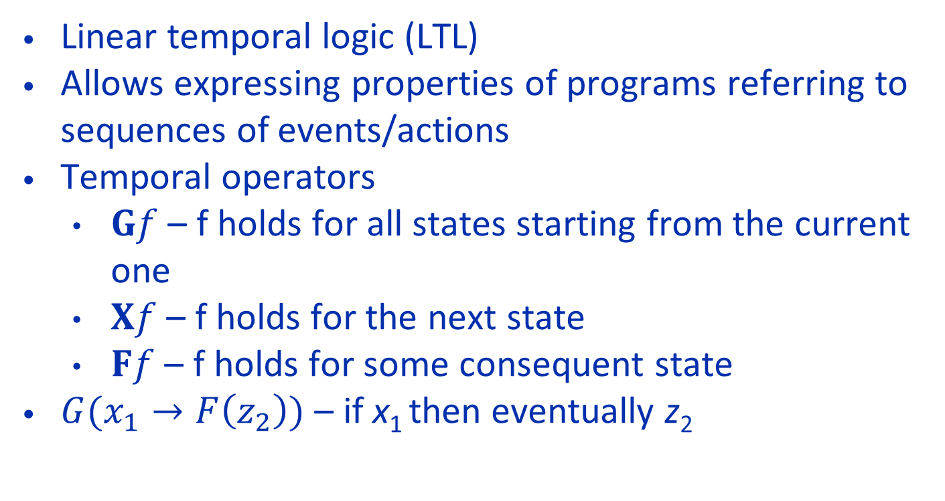
Temporal formulas
Linear temporal logic (LTL)
Allows expressing properties of programs referring to sequences of events/actions
Temporal operators
$Gf$ – f holds for all states starting from the current one
$Xf$ – f holds for the next state
$Ff$ – f holds for some consequent state
$G(x_{1}→F\left(z_{2}\right))$ – if x₁ then eventually z₂
Notes:
For expressing temporal specification we use linear temporal logic that allows expressing properties of programs referring to sequences of events or actions. An example of an LTL property is “Always, if signal x1 is received then at some time in the future actuator z2 will be triggered”.

Slide 9
Existing approaches
Metaheuristic: [Chivilikhin et al. / INDIN’16]
Rather slow
Incomplete
LTL synthesis [Faymonville et al. / TACAS’17]
Does not support execution traces
Large state machines
SAT-based incremental counterexample elimination [Ulyantsev et al. / STTT’18]
Uses a very simple state machine model
Insufficient for large # of input/output variables
Notes:
Existing approaches to the considered problem, to the best of our knowledge, are insufficient. Our previous metaheuristic approach does not scale to large specifications and models since it uses too many calls to the model checker. LTL synthesis approaches do not have efficient support for execution traces and produce large incomprehensible state machines. Last, the SAT-based incremental counterexample elimination approach works well for moderate controllers with small input/output alphabets, but is not well-suited to industrial controller reverse engineering.

Slide 10
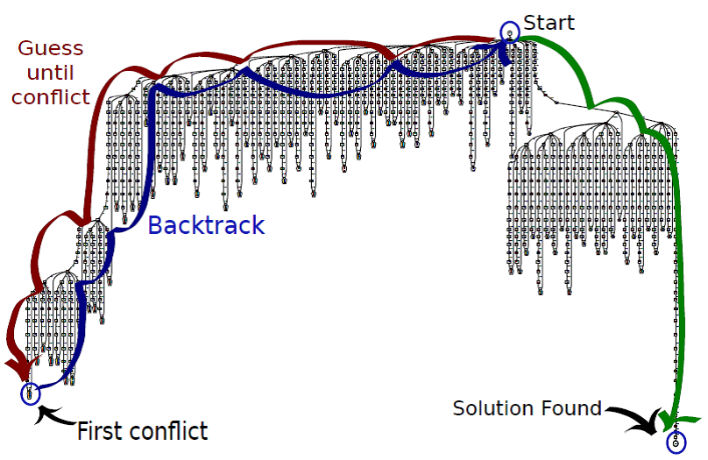
Proposed approach: translation to Constraint Satisfaction Problem
Data
CSP-solver
Solution reconstruction
Solution
Encoding
Minimize #states, #transitions and the guard conditions of the state machine
Use closed-loop model checking for getting counterexamples
https://srlabs.de/bites/minisat-intro/
Notes:
Our approach relies on translation of the controller synthesis problem to constraint satisfaction problem and use of the CSP-solver. Main characteristics of our approach in contrast with existing ones are that, first, we minimize number of states and transitions of the state machine as well as the complexity of guard conditions, and, second, we use closed-loop model checking for getting new counterexamples.

Slide 11
Proposed approach scheme
increase
# states N
# transitions R
Translation function
Constraints ℂ on variables 𝕍 with domains 𝔻
CSP solver
No solution
(UNSAT)
Automaton
Verification
LTL
Positive traces
Negative traces
ok
Counter-
example
Done.
Notes:
We start constructing the positive traces tree from collected execution traces and setting constant numbers of states and transitions. This input data is fed to the translation function, which constructs a system of constraints satisfiable if and only if there exists a controller with N states and R transitions that follows the behavior described by positive traces. If such a controller does not exist, parameters are increased accordingly. If an automaton is constructed, it is verified in closed-loop against supplied LTL properties. If all properties are satisfied, the problem is solved. Otherwise, one or more counterexamples are generated. They are aggregated into a negative traces tree, which sums behaviors that should NOT be demonstrated by the controller. On the next iteration we construct a system of constraints satisfiable if and only if, first, the controller follows behaviors described by the positive tree, and, second, does not exhibit behaviors stored in the negative tree.

Slide 12
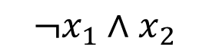
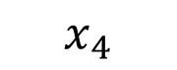
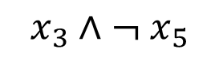
State machine model: transitions
$$x_{3}∧{ ¬ x}_{5}$$
1
$${¬x}_{1}∧x_{2}$$
2
3
$$x_{4}$$
 | Source/ destination | Input variable | Literal sign
r | S_{r} | d_{r} | g_{*,1} | g_{*,2} | α_{*,1} | α_{*,2}
1 | 1 | 2
1 | 2 | 0 | 1
2 | 2 | 3
3 | 5 | 1 | 0
3 | 3 | 2
4 | 6 | 1 | 0
Notes:
We model the controller as a state machine with R transitions and N states. Each state has a source and destination state. A guard condition is modeled as a Boolean formula which only uses negation and conjunction. For each transition, g-variables represent the input variables used in the guard condition and alpha-variables represent literal signs.

Slide 13
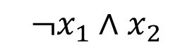
State machine model: states
State 1
State 2
z1 := FALSE;
z2 := FALSE;
z3 := FALSE;
$${¬x}_{1}∧x_{2}$$
z1 := TRUE;
z3 := FALSE;
State | z1 | z2 | z3
1 | FALSE | FALSE | FALSE
2 | TRUE | * | FALSE
Notes:
Algorithms in controller states are modeled by simple TRUE/FALSE assignments for each variable. If there is no need to change a variable, a corresponding expression can be omitted.

Slide 14
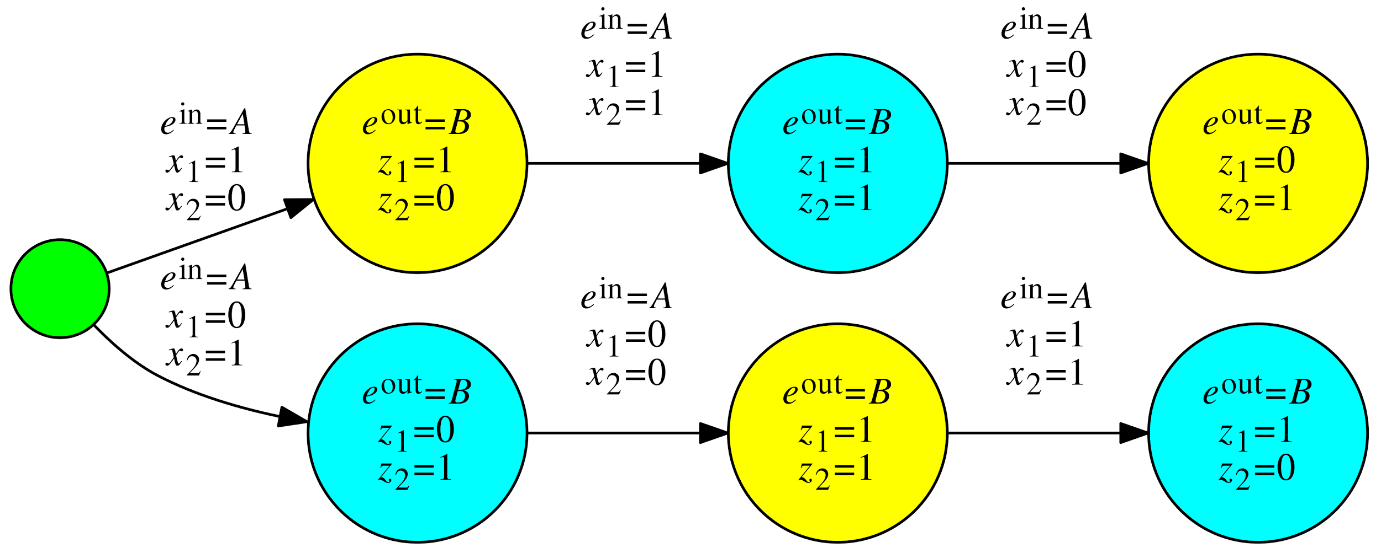
Positive traces tree
Notes:
The positive traces tree includes all prefixes of all positive traces. In general, the main idea of positive tree constraints is to color the tree in N colors such that if we merge all tree nodes with the same color into one state, the resulting machine would be (1) deterministic and (2) satisfy all input traces.

Slide 15
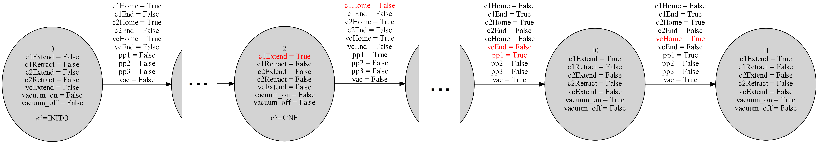
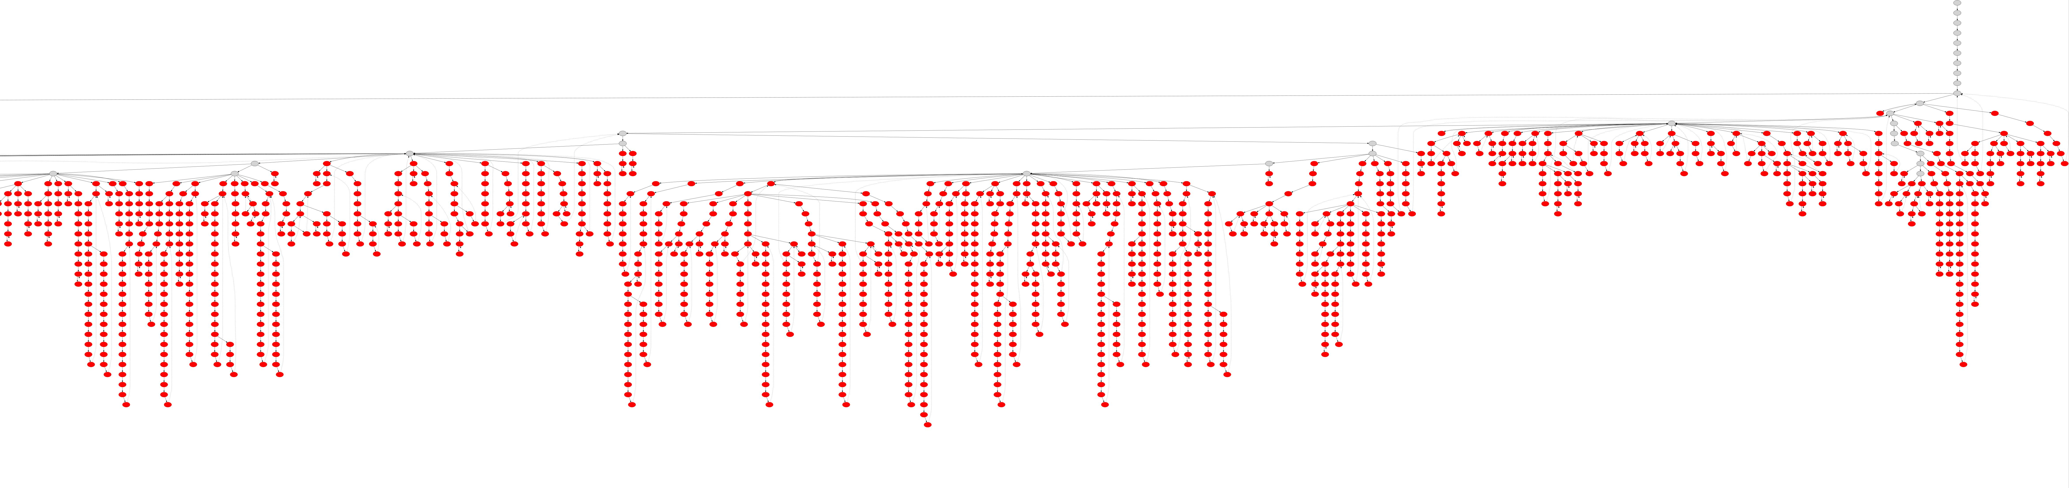
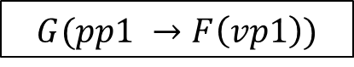
Counterexamples & negative tree
LTL formula
$$G(pp1 →F\left(vp1\right))$$
NuSMV model checker
Counterexample
Negative tree
Notes:
The most interesting part is the constraints induced by the negative tree. If on the current iteration we construct an automaton, we check each LTL property using the model checker. If this results in a counterexample, we add it to the counterexample tree.
A counterexample is a sequence of computational states that represents a violation of the temporal property. Counterexamples to LTL properties can be represented as a finite prefix followed by an infinite loop, which is represented by the dotted back-edge that leads from the end of the counterexample to the beginning of the loop.
Then, on the next iteration we add constraints such that the new counterexample may not be discovered for the next controller.

Slide 16
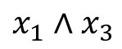
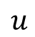
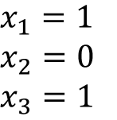
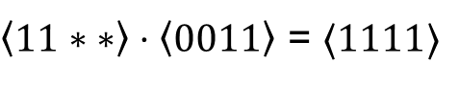
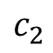
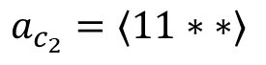
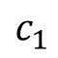
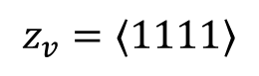
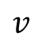
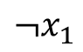
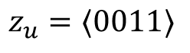
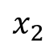
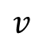
Main negative tree constraints (1)
Propagate color c₂ to node v if:
1. Vertex u has color c₁
2. Automaton has corresponding transition
3. State c₂ correctly transforms output variables
$$x_{2}$$
$$z_{u}=⟨0011⟩$$
$${¬x}_{1}$$
$$u$$
$$c_{1}$$
$${\begin{aligned}x_{1}=1 \\ x_{2}=0 \\ x_{3}=1\end{aligned}}_{}$$
$$x_{1}∧x_{3}$$
$$v$$
$$v$$
$$z_{v}=⟨1111⟩$$
$$c_{2}$$
$$a_{c_{2}}=⟨11∗ ∗⟩$$
$\left\langle 11∗ ∗\right\rangle ⋅\left\langle 0011\right\rangle$ = $⟨1111⟩$
Notes:
Negative tree constraints have two parts. The first is coloring the negative tree using the state machine model – this is done to discover which behaviors recorded in the tree are possible for the controller. Consider an edge of the tree uv and suppose vertex u has color c1. If the automaton has a transition that is fired for the input variable values on edge uv, and the algorithm in state c2 allows to correctly transform output variables values, then the color c2 is propagated to vertex v.

Slide 17
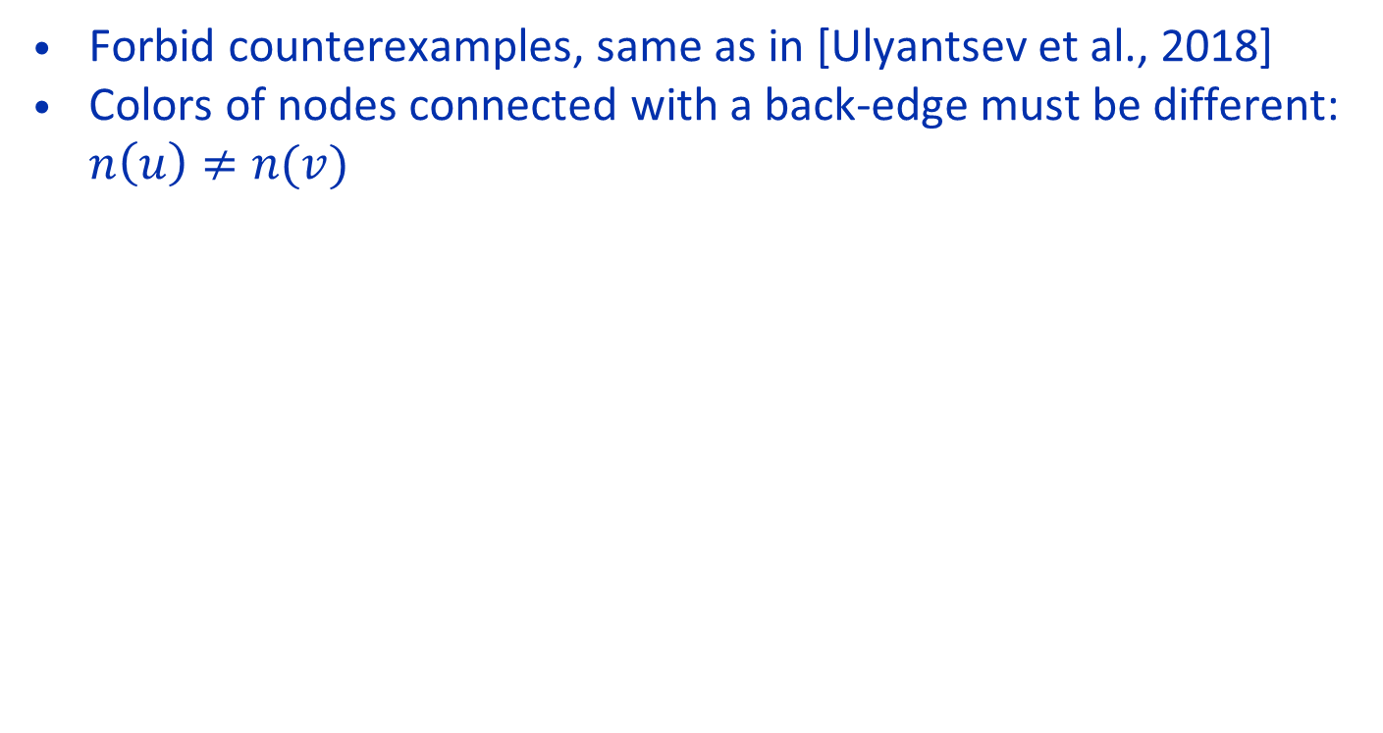
Main negative tree constraints (2)
Forbid counterexamples, same as in [Ulyantsev et al., 2018]
Colors of nodes connected with a back-edge must be different: $n\left(u\right)≠n(v)$
u
v
Ulyantsev V., Buzhinsky I., Shalyto A. Exact Finite-State Machine Identification from Scenarios and Temporal Properties. International Journal on Software Tools for Technology Transfer, vol. 20, no. 1, pp. 35–55
Notes:
The second part is forbidding counterexamples – ensuring that the new controller does not show behaviors recorded in all counterexamples. This is done exactly the same as in Ulyantsev et al – we add constraints stating that nodes connected with a back-edge must have different colors.

Slide 18
Main algorithm
Notes:
The main algorithm is described by this pseudocode. We start from the positive traces tree T+ and temporal properties f. The findModel function represents a call to the translation function and the CSP-solver that tries to find an automaton that behaves as described by T+, does not behave as described by T- and has a specific size. If the solver call results in UNSAT, we increase values of parameters and run again. Otherwise, we get a state machine A and verify temporal properties. Generated counterexamples are added to the negative tree T-. The algorithm terminates when there are no counterexamples for all temporal formulas.

Slide 19
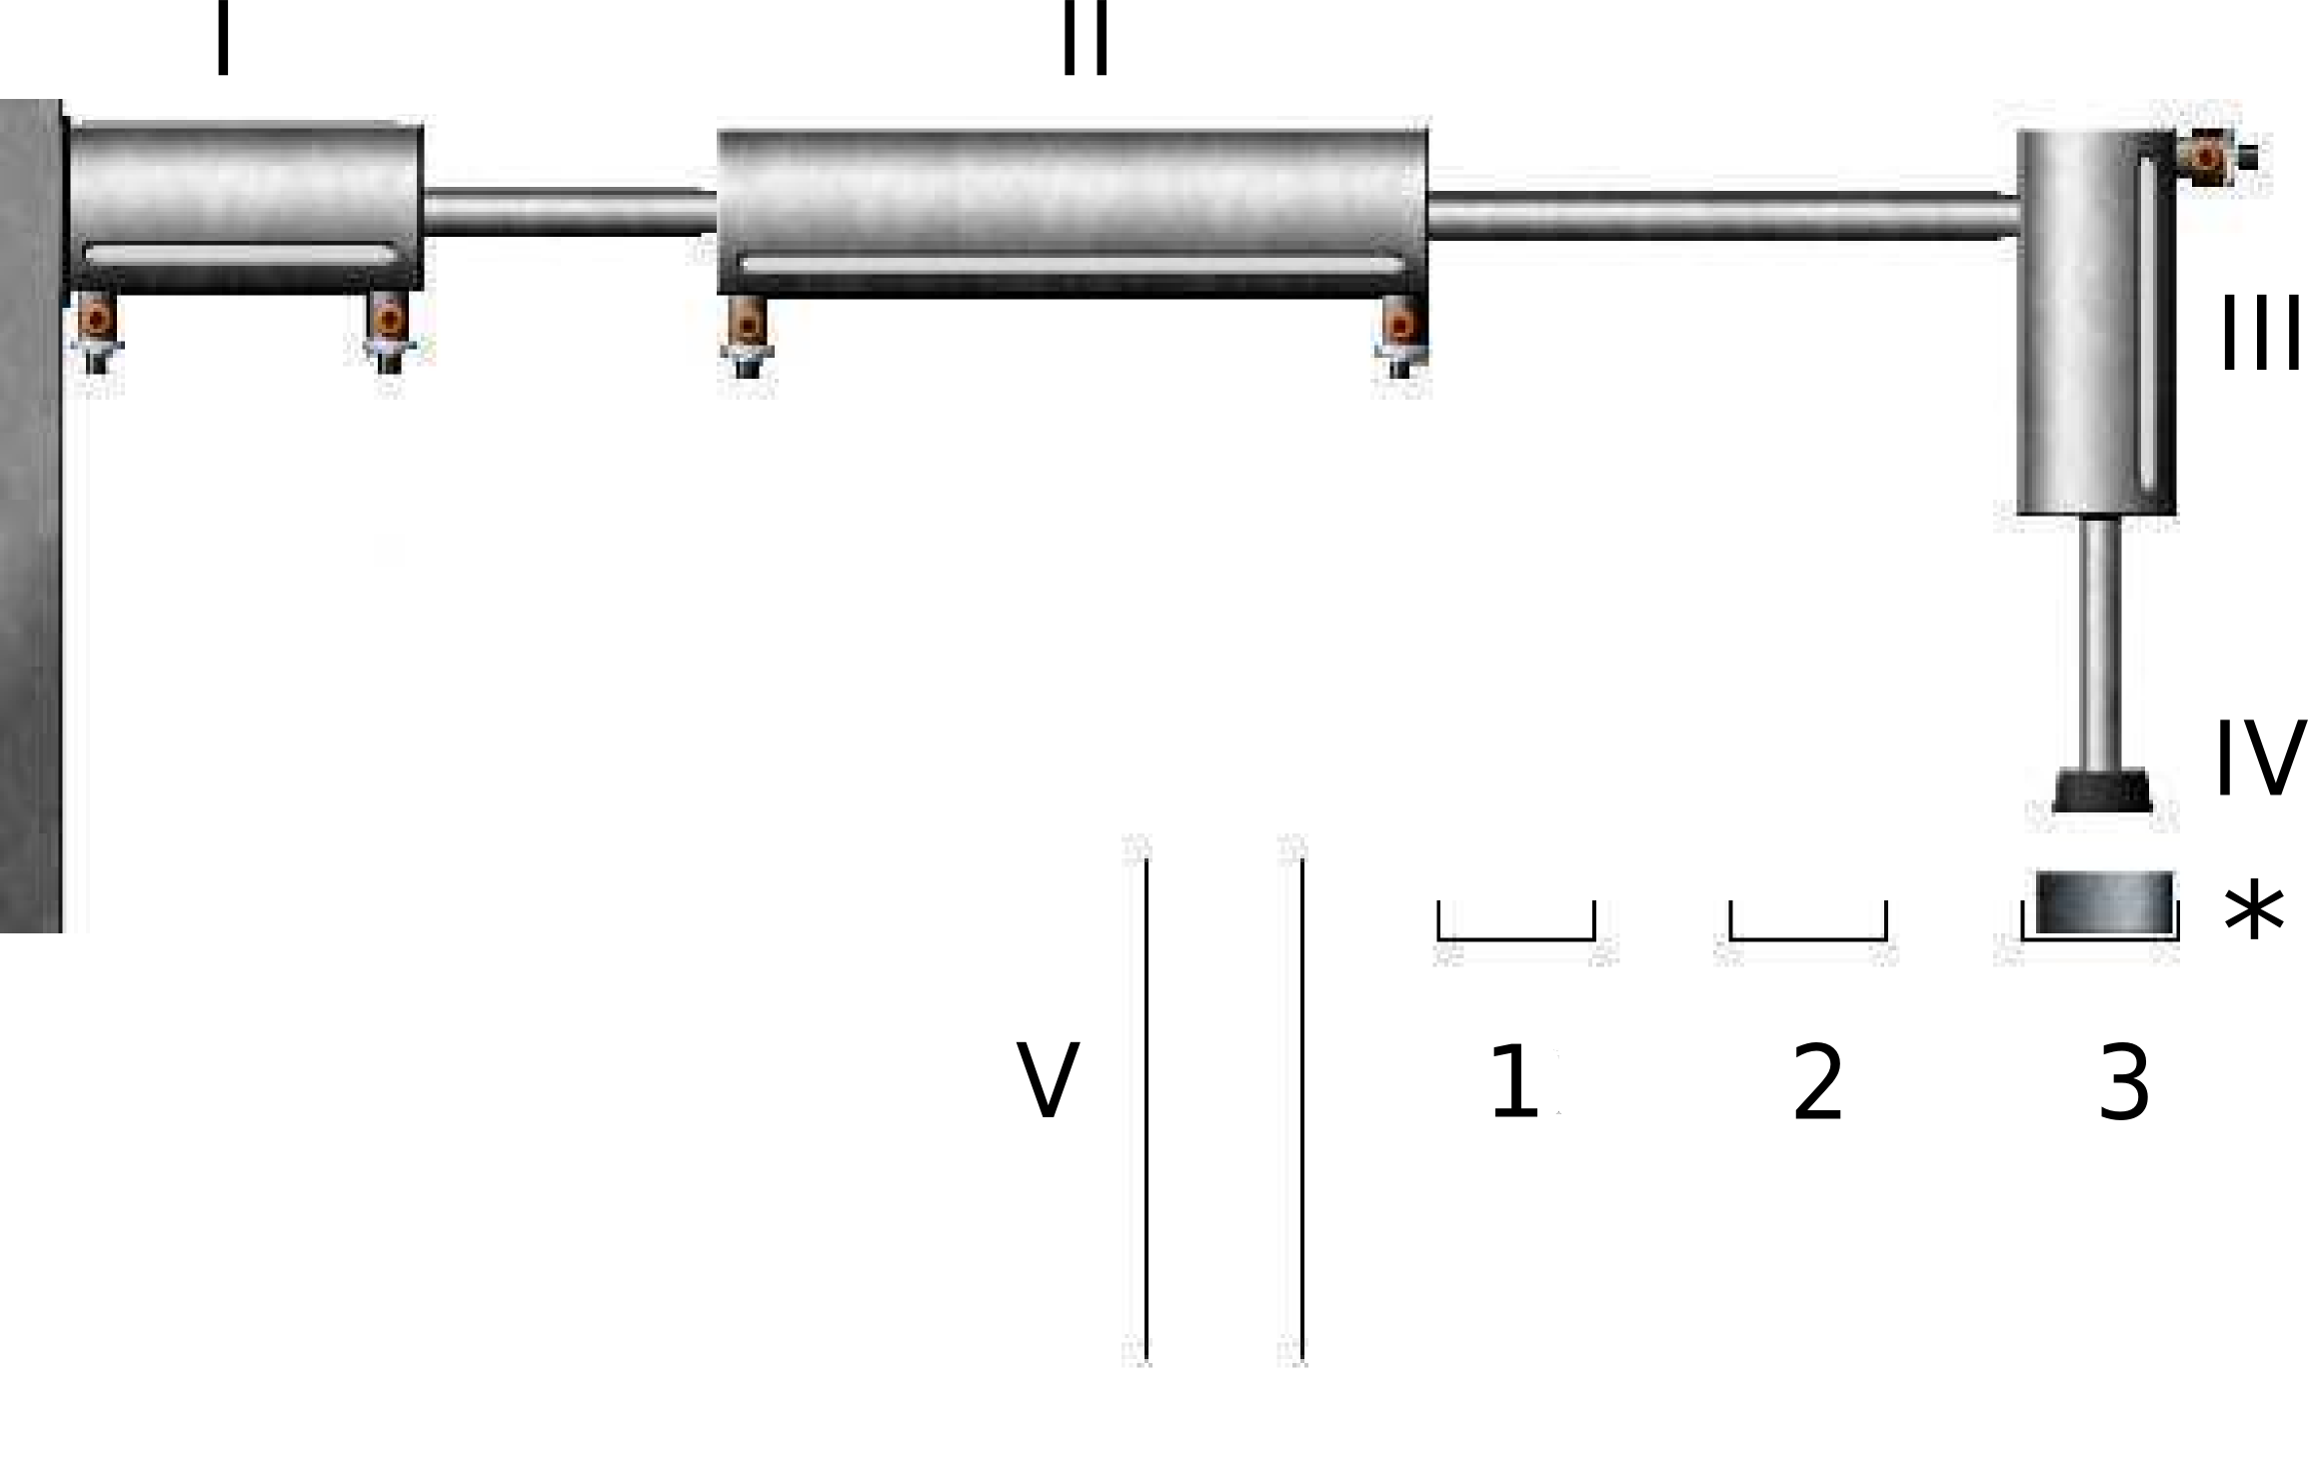
Case study: Pick-and-Place manipulator
Goal – generate controller model from
Small set of traces
LTL specification
Notes:
We tested our algorithm on the example of generating a controller for the Pick-and-Place manipulator system. The system moves work pieces that appear on input sliders 1-3 to the output slider V. The goal of the experiments was to construct a controller using a small set of traces and an LTL specification.

Slide 20
LTL specification
No contradicting commands
WP is always eventually lifted from slider 1
Notes:
Used LTL specification consists of eight properties, but the main one is #6: it requires that if a work piece appears on input slider 1, it will always eventually be lifted.

Slide 21
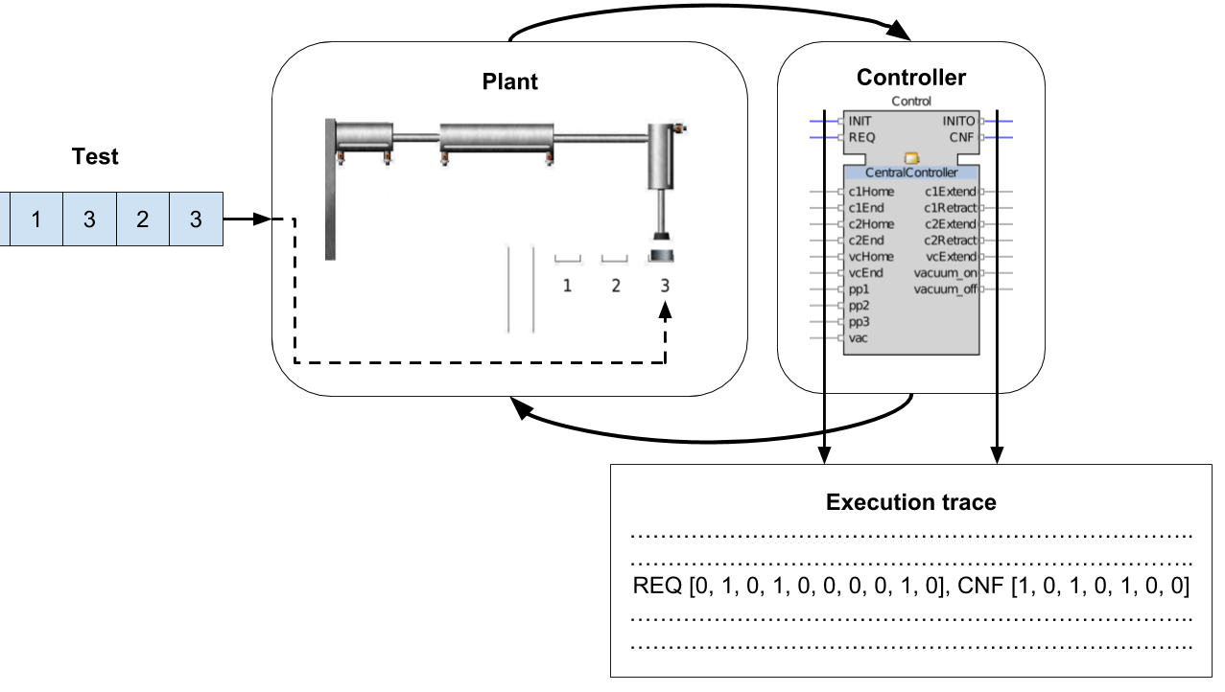
Positive traces generation
All tests with length = 1, 2, 3
#1: 1
#2: 2
…
#12: 1, 1, 1
…
#39: 3, 3, 3
Notes:
Positive traces generation was done based on tests. For example, a test <1, 2, 3> represents processing one work piece from slider 1, then one piece from slider 2, and one piece from slider 3. We used 39 tests: from <1> (one work piece from slider 1) to <3, 3, 3> (three work pieces from slider 3 in a row).

Slide 22
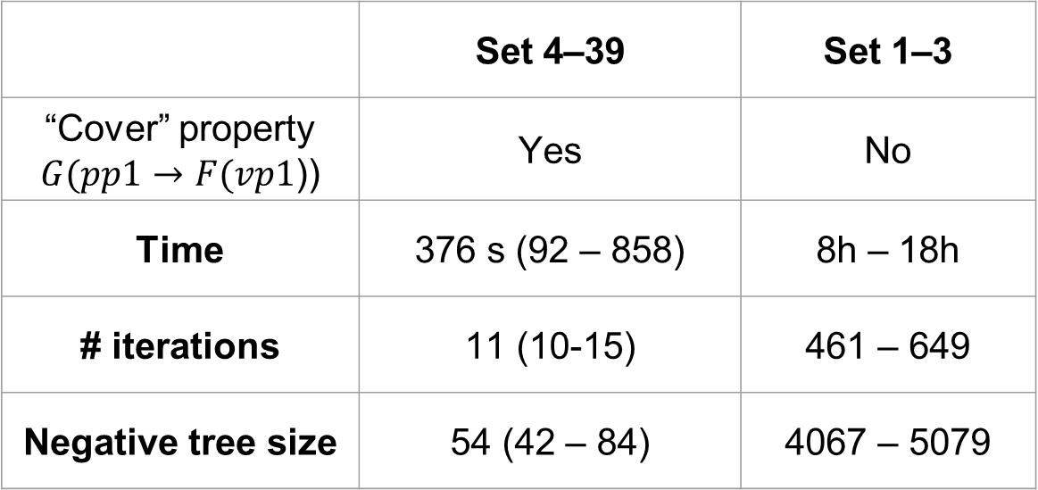
Experimental results
 | Set 4–39 | Set 1–3
“Cover” property $G(pp1→F(vp1$)) | Yes | No
Time | 376 s (92 – 858) | 8h – 18h
# iterations | 11 (10-15) | 461 – 649
Negative tree size | 54 (42 – 84) | 4067 – 5079
Notes:
Traces were organized in sets: set 1 contains only traces 1, set 2 contains traces 1 and 2, set 39 contains all traces. These sets can be conditionally classified based on our main LTL property. We can say that a traces set “covers” this property if it contains a trace in which the work piece from slider 1 is processed at least twice. So, sets 1-3 do not cover our property, while all other sets 4-39 cover it. This property has a drastic effect on algorithm performance – time required to construct a correct solution and number of iterations of the algorithm. Another interesting parameters is the size of the negative tree on the last iteration of the algorithm – it shows exactly how much search the algorithm performed based on counterexamples.

Slide 23
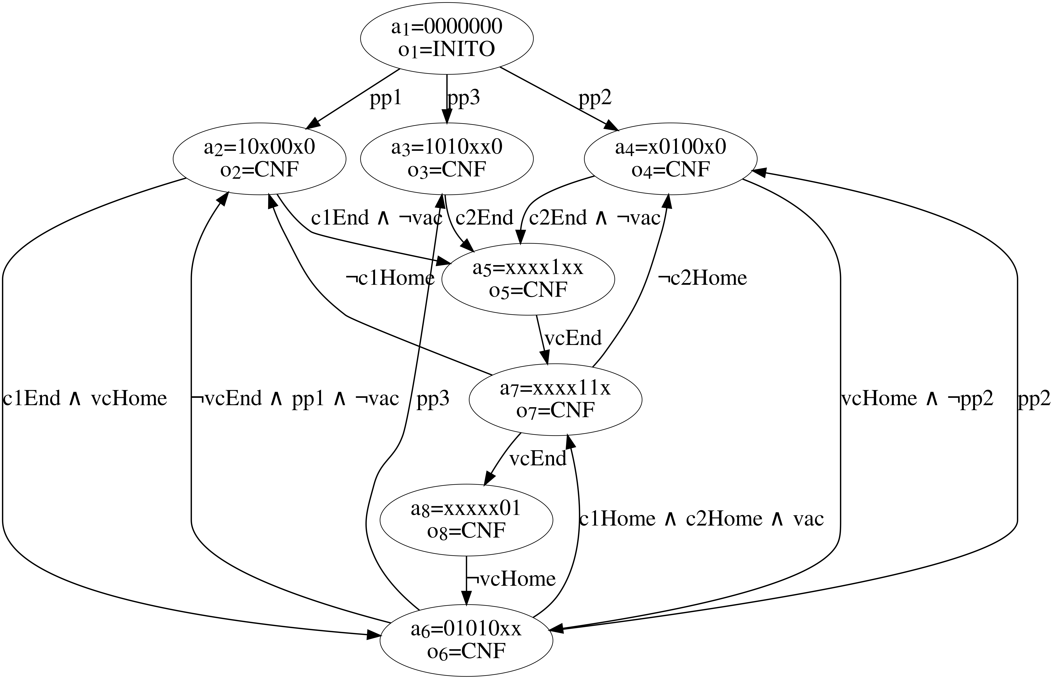
Generated model example
Results were validated by closed-loop simulation of generated controllers in NxtStudio
Notes:
This is an example of a generated controller for the Pick-and-Place system. Constructed controllers were validated via closed-loop simulation in NxtStudio.

Slide 24
Conclusion & Future work
Developed a counterexample-guided approach for synthesizing controllers from behavior examples and temporal logic specification
Demonstrated its viability on the example of Pick-and-Place manipulator IEC 61499 controller synthesis
Future work
Use automatically generated plant models [Buzhinsky et al. / TII’17; Ovsiannikova et al., ETFA’18]
Use SPIN instead of NuSMV [Buzhinsky et al. / IECON’17]
Use incremental SAT-solver instead of CSP-solver
New case studies

Slide 25

Thank you for your attention!

